Slide 1

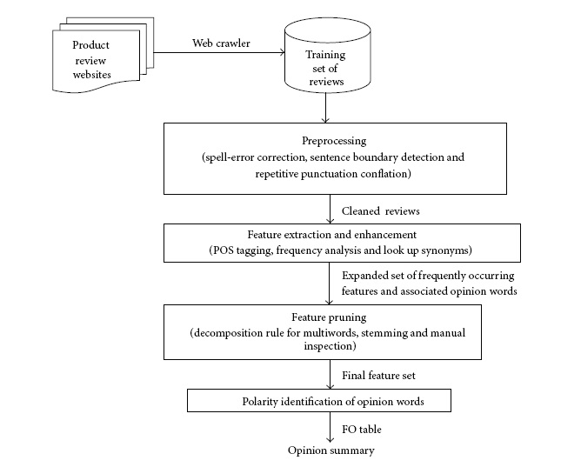
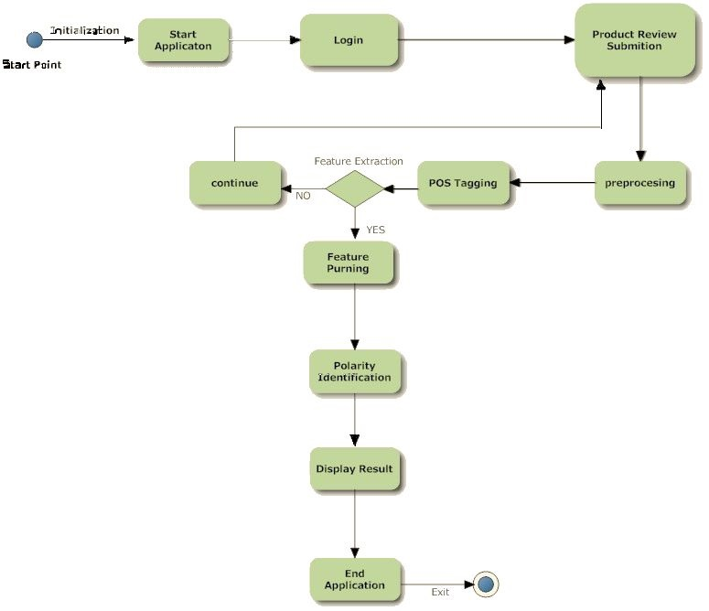
Mahavir Education Trust‘s Shah & Anchor Kutchhi Engineering College, Chembur, Mumbai 400 088 UG Program in Computer Engineering
E-COMMERCE PRODUCT REVIEW MANAGEMENT SYSTEM BASED ON OPINION MINING
Abstract
The growth of E-commerce has led to the invention of several websites that market and sells products as well as allows users to post reviews. It is typical for an online buyer to refer to these reviews before making a buying decision. Hence, automatic summarization of users’ reviews has a great commercial significance. However, since the product reviews are written by non experts in an unstructured, natural language text, the task of summarizing them is challenging. This Project presents a semi supervised approach for mining online user reviews to generate comparative feature-based statistical summaries that can guide a user in making an online purchase.
Architecture Diagram
Working
An opinion review database by crawling some popular websites that categorically post product reviews by actual users was generated. The product opinion summarizer has three main phases.
Preprocessing Phase:
This phase requires parts-of- speech tagging which works at the sentence level. Thus, it becomes important to detect end of sentences. So, in this phase basic cleaning tasks like sentence boundary detection and spell-error correction is done.
Feature Extraction Phase:
In this phase, opinion features from the pre-processed review text obtained from the previous phase are extracted. Frequently occurring nouns (N) and noun phrases (NP) are treated as possible opinion features and associated adjectives, describing them as indicators of their opinion orientation. Parts-of- speech (POS) tagging on the review sentences using the Link Grammar Parser is performed.
Opinion Summarization and Classification Phase:
In the previous phase extraction of opinion features, adjectives describing them, and any modifiers if present was done. A statistical feature-wise summary for each product which enables comparison of different brands selling similar products is generated. In order to determine the sentiment polarity of an adjective describing an opinion feature ,SentiWordNet is used.
Activity Flow
Introduction
There are many users who purchase products through E-commerce websites. Through online shopping many E-commerce enterprises were unable to know whether the customers are satisfied by the services provided by the firm. This boosts us to develop a system where various customers give reviews about the product and online shopping services, which in turn help the E-commerce enterprises and manufacturers to get customer opinion to improve service and through mining customer reviews. The objective of this project is to develop a system which will help customers who are buying products online to understand the popularity and efficiency of the product through the sentiments of customers who have used that product and reviewed them. The main goal of our project is to provide a prototype system that could be used to track customer reviews, the opinion of customers who bought that product, provide detailed comparison of features through data mining techniques and sentiment analysis from online customer reviews.
Conclusion
Classifying and summarizing opinions of bloggers has several interesting and commercially significant applications. It was empirically proved that the proposed approach for product feature set extraction, that is, using frequent multi words with decomposition strategy outperforms other contemporary approaches like the Apriori-based approach and the seed-set expansion approach. Empirical results indicate that the multistep feature based semi supervised opinion mining approach used in this project can successfully identify opinionated sentences from unstructured user reviews and classify their orientation with acceptable accuracy. This enables reliable review opinion summarization which has several commercially important applications.
References
1. M.Hu and B. Liu, “Mining and summarizing customer reviews,” in Proceedings of the 10th ACMSIGKDD International Conference on Knowledge Discovery and Data Mining (KDD ‘04), pp. 168–177, August 2004.
2. M. A. Jahiruddin, M. N. Doja, and T. Ahmad, “Feature and opinion mining for customer review summarization,” in Proceedings of the 3rd International Conference on Pattern Recognition and Machine Intelligence (PReMI ’09), vol. 5909 of Lecture Notes in Computer Science, pp. 219–224, 2009.
3. S. Huang, X. Liu, X. Peng, and Z. Niu, “Fine-grained product features extraction and categorization in reviews opinion mining,” (ICDMW’12), pp. 680–686, 2012.
Project Group
1. Apresh Pandit 2. Sujith Nair
3. Sanal Pillai 4. Onkaar Sawant
Under The Guidance of
Ms. Rupali Kale

